Slide 1
Coexistence of LTE-LAA and Wi-Fi: analysis, simulation and experiments
Monisha Ghosh
Research Professor, University of Chicago
Collaborators:
UChicago: Vanlin Sathya, Muhammad Iqbal
University of Washington: Morteza Mehrnoush, Sumit Roy
Acknowledgements: Supported by NSF Award Nos. 1618920 and 1617153
Computer Science

Slide 2
Prologue
Presidential Memorandum on Developing a Sustainable Spectrum Strategy For America’s Future, Oct. 25, 2018 https://www.whitehouse.gov/presidential-actions/presidential-memorandum-developing-sustainable-spectrum-strategy-americas-future/
  increase spectrum access for all users, including on a shared basis, through transparency of spectrum use and improved cooperation and collaboration between Federal and non-Federal spectrum stakeholders;
  create flexible models for spectrum management, including standards, incentives, and enforcement mechanisms that promote efficient and effective spectrum use, including flexible-use spectrum licenses, while accounting for critical safety and security concerns;
  use ongoing research, development, testing, and evaluation to develop advanced technologies, innovative spectrum-utilization methods, and spectrum-sharing tools and techniques that increase spectrum access, efficiency, and effectiveness;
  build a secure, automated capability to facilitate assessments of spectrum use and expedite coordination of shared access among Federal and non-Federal spectrum stakeholders;
FCC NPRM on 6 GHz, Oct. 23, 2018, https://www.fcc.gov/document/fcc-proposes-more-spectrum-unlicensed-use-0
Computer Science

Slide 3
Topics
Detection mechanism:
  What are the appropriate sensing levels for LTE and Wi-Fi to detect each other?
  Can LTE and Wi-Fi detect each other reliably without a common preamble?
TXOP:
  How does the TXOP used by LTE affect Wi-Fi throughput?
  We address the above issues through analysis, system level simulations using ns-3 and experimentation using SDRs and Wi-Fi devices.
Computer Science

Slide 4
Methodology
Analysis:
  Modifying Bianchi’s method to theoretically analyze coexistence with different detection threshold and TXOPs.
Simulation:
  Enhancing the coexistence module in ns-3 to perform system level simulations that allow different configurations for testing.
Experiments:
  Using NI USRPs with the 802.11 and LTE Application Frameworks, along with Wi-Fi routers and devices to perform testing in realistic environments.
Computer Science

Slide 5
Coexistence in unlicensed bands: what is fair sharing?
Airtime fairness: each system gets 50% of air-time
Throughput fairness
  Seems to be the most relevant, but harder to guarantee.
  Wi-Fi achieves this intrinsically.
  LTE achieves this by scheduling.
  How should this be done when they coexist?
Access fairness
  Each system should have equal access to the channel when one is already on the air.
Latency fairness
  Low latency requirements may become quite hard to meet.
Computer Science

Slide 6
Existing sensing levels
Wi-Fi/Wi-Fi: preamble detection threshold -82 dBm.
Wi-Fi/LTE-LAA: Wi-Fi uses an energy detection threshold of -62 dBm to detect all other users, including LTE-LAA.
LTE-LAA has specified -72 dBm as the energy detection threshold to be used to protect Wi-Fi.
The two systems are NOT treating each other symmetrically
Computer Science

Slide 7
Sensing threshold combinations
LTE-LAA ED -62 dBm Wi-Fi ED -62 dBm:
  Could make the problem of hidden nodes worse
LTE-LAA ED -82 dBm Wi-Fi ED -62 dBm:
  Proposed by Wi-Fi Alliance
LTE-LAA ED -82 dBm Wi-Fi ED -82 dBm:
  Could improve performance for both?
Computer Science

Slide 8
Coexistence set-up with ns-3
There are two steps in the experiment
  Step 1: Cell A and Cell B both use Wi-Fi
  Step 2: Cell A switches to LTE-LAA and Cell B continues using Wi-Fi.
Cell B: Always Wi-Fi, blue users
Cell A: Switches between Wi-Fi/LTE-LAA, red users
Computer Science

Slide 9
Performance Metrics
Mean throughput: The average throughput over multiple file transfers is calculated as number of total successfully received bytes divided by total transmission time.
Mean Latency: The average of latency over multiple file transfers is calculated from time of packet arrival in the MAC buffer to successful transmission (including re-transmission).
Computer Science

Slide 10
Throughput Performance with LTE-LAA
Key takeaway: LTE-LAA and Wi-Fi throughput improve when both sense at – 82 dBm
Computer Science

Slide 11
Latency Performance with LTE-LAA
Key takeaway: LTE-LAA and Wi-Fi latency improve when both sense at – 82 dBm
Computer Science

Slide 12
Preliminary experimental results using NI SDR
TXOP = 8 ms | Cell B | Cell A
Step 1 | 34.6 | 34.1
ED_L -62 ED_W -62 | 6.2 | 54
ED_L -82 ED_W -62 | 5.9 | 51
ED_L -62 ED_W -82 | 7 | 56
ED_L -82 ED_W -82 | 8.2 | 57.6
TXOP = 6 ms | Cell B | Cell A
Step 1 | 34.6 | 34.1
ED_L -62 ED_W -62 | 18 | 46
ED_L -82 ED_W -62 | 16 | 43.6
ED_L -62 ED_W -82 | 19 | 47
ED_L -82 ED_W -82 | 21.6 | 50
TXOP = 4 ms | Cell B | Cell A
Step 1 | 34.6 | 34.1
ED_L -62 ED_W -62 | 26.6 | 42
ED_L -82 ED_W -62 | 23 | 39
ED_L -62 ED_W -82 | 24.5 | 43.2
ED_L -82 ED_W -82 | 28 | 46
Distance between LTE-LAA BS and Wi-Fi AP = 30 feet.
System BW = 20 MHz
802.11a mode
Computer Science

Slide 13
LTE detection
In order for Wi-Fi and LTE to treat each other differently from “other” signals, they need to recognize each other reliably.
While a common preamble can help with this, we also investigated methods of using signal features to do so, using simple correlators.
We focus on detecting LTE reliably at a Wi-Fi device using the known cyclic prefix of the OFDM symbol.
Computer Science

Slide 14
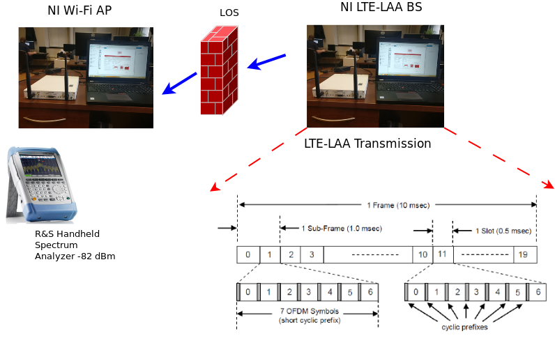
Experimental set-up
S.NO | Hardware Requirements
1 | 2 SDR RIO 2953: One SDR act as a Wi-Fi AP and other as LTE-LAA.
2 | 2 Laptop with 8 GB RAM (Installed Memory), 64-bit operating system, x64-based processor, Intel(R) Core i7, CPU clock 2.60GHz.
3. | R & S Spectrum analyzer capable to support up to 13 GHz.
Computer Science

Slide 15
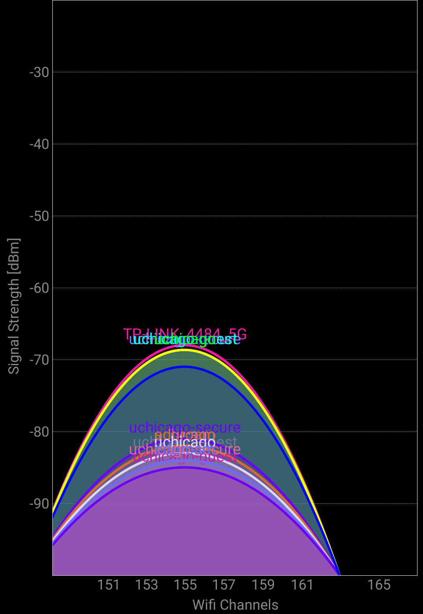
Experimental parameters
Parameter | Value
Wi-Fi ED threshold | -82 dBm
LTE-LAA and Wi-Fi operating channel | 5.825 GHz (Channel no 165)
LAA and Wi-Fi transmission power | 23 dBm
Wi-Fi and LAA bandwdith | 20 MHz
LAA control and data channels | PDCCH and PDSCH
Average number of experiment run | 10 times per threshold
LTE-LAA TXOP | 4 ms
Experiment channel @ UChicago
Computer Science

Slide 16
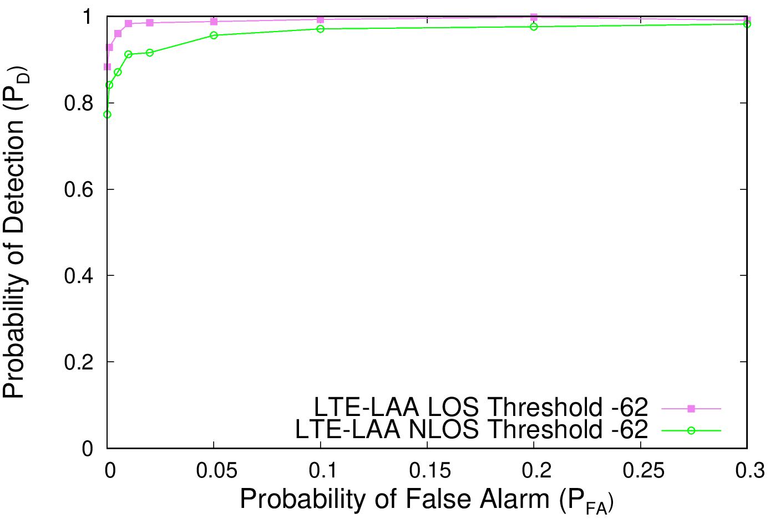
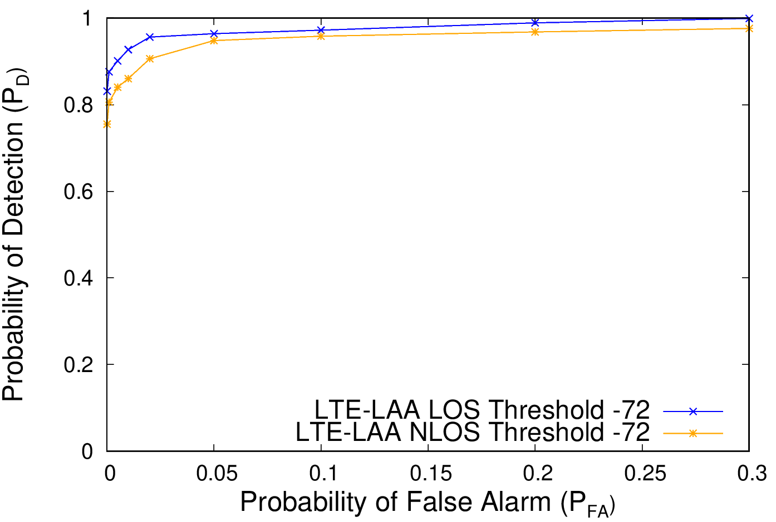
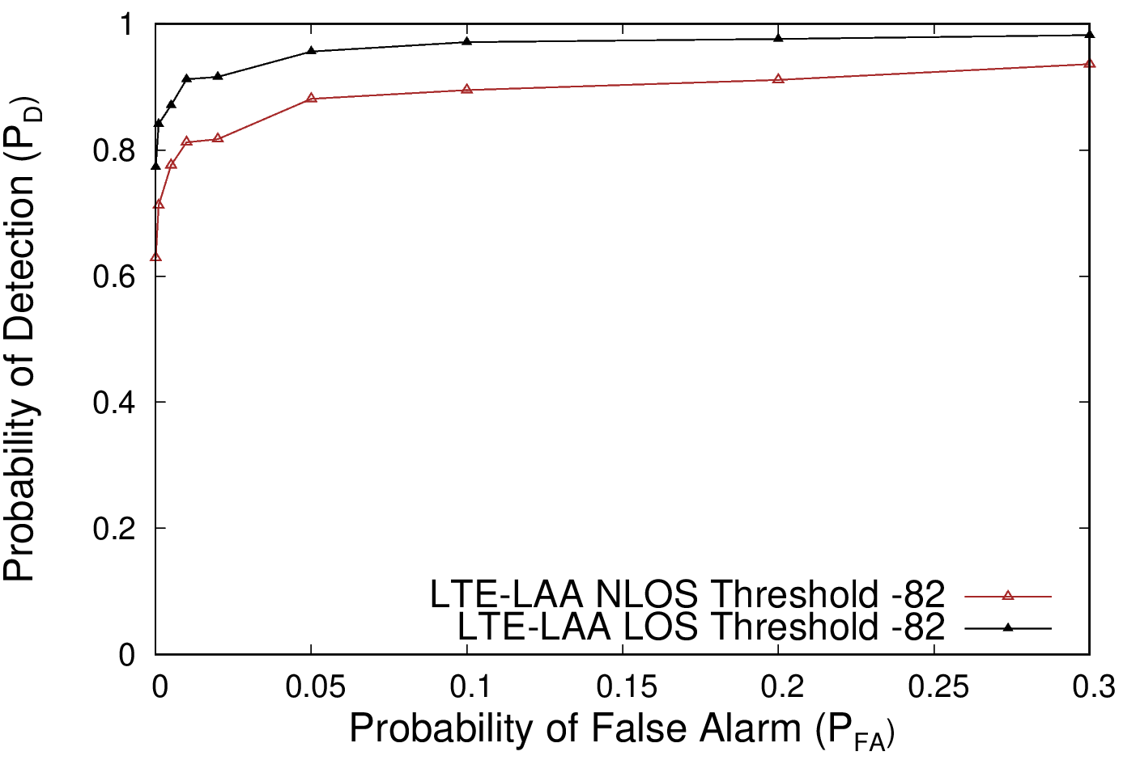
Cyclic Prefix (CP) based Detection Algorithm
Performance degrades in NLOS channels: expected
Performance degrades at – 82 dBm as compared to – 62 dBm: expected
Above degradations can be addressed by incorporating detection of other synchronization signals
Computer Science

Slide 17
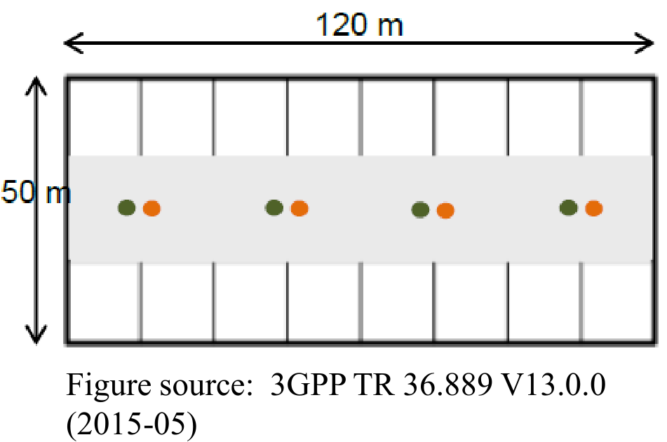
TXOP Simulations in ns-3
Scenario: TR 36.889
8 Cells, 5 Users each
  LAA and Wi-Fi each have 4 cells
LTE-LAA ED: -82 dBm
Wi-Fi ED: -82 dBm
Transmission power: 23 dBm
Scheduling algorithm: Proportional Fair
Traffic: FTP model 1, lambda=2.5
LTE-LAA on unlicensed only for DL
Computer Science

Slide 18
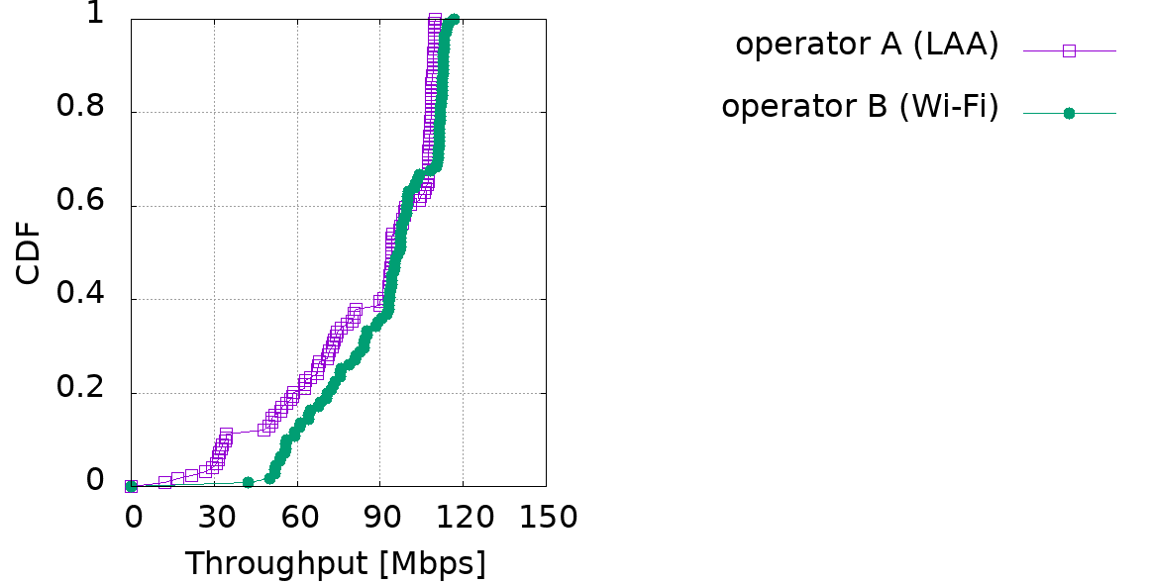
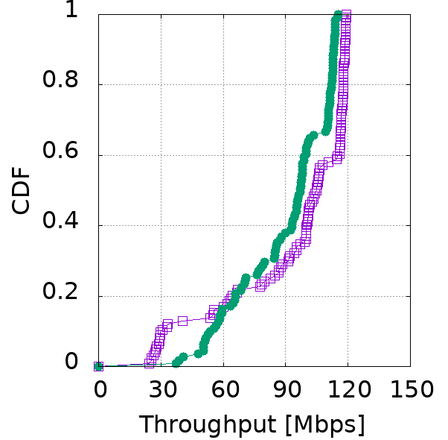
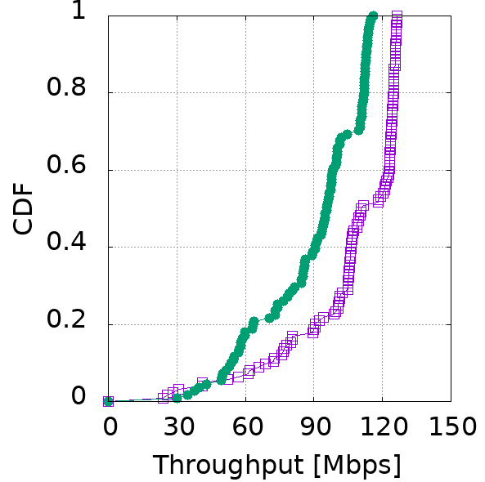
Throughput as a function of TXOP
TXOP = 4 ms
TXOP = 6 ms
TXOP = 8 ms
A TXOP of 6 ms and symmetrical energy detection thresholds of – 82 dBm ensure each system comparable throughput
Computer Science

Slide 19
Key findings
Wi-Fi and LTE-LAA have improved throughput and latency performance when the detection threshold used by Wi-Fi in the presence of LTE is lowered to -82 dBm, and LTE-LAA does the same.
Hence, the result points to a coexistence scenario where Wi-Fi uses the same -82 dBm threshold to protect against Wi-Fi or LTE-LAA and continues to use -62 dBm against unknown noise or other interferers.
In order for Wi-Fi to distinguish between LTE-LAA and other signals, Wi-Fi would need to implement LTE detection, which can be easily implemented by detecting the LTE synchronization signals. Common premables may be another option.
A TXOP of 6 ms along with symmetric detection threshold leads to equitable throughput.
Computer Science

Slide 20
Final thoughts
Spectrum sharing is here to stay: this is the new spectrum reality for licensed and unlicensed users, federal and commercial users.
Lessons learnt from coexistence at 5 GHz should be used proactively in 6 GHz and future bands to avoid the situation where an installed base of devices forestalls coexistence with future systems, which are yet unknown. Need to future-proof standards.
Coexistence in unlicensed bands works best when detection thresholds and air-times are symmetric.
The community needs open test-beds and platforms, both software and hardware, that can provide a means for obtaining unbiased results.
Computer Science

Slide 21
References
M. Mehrnoush, S. Roy, V. Sathya and M. Ghosh, “On the fairness of Wi-Fi and LTE-LAA coexistence,” IEEE Transactions on Cognitive Communications and Networking, Dec. 2018.
V. Sathya, M. Mehrnoush, M. Ghosh and S. Roy, “Energy detection based sensing of multiple Wi-Fi BSSs for LTE-U CSAT,” IEEE Globecom 2018, December 2018.
M. Mehrnoush, V. Sathya, S. Roy and M. Ghosh, “Analytical Modeling of Wi-Fi and LTE-LAA Coexistence: Throughput and Impact of Energy Detection Threshold,” IEEE/ACM Transactions on Networking, vol. 26, pp. 1990 – 2003, Aug. 2018.
V. Sathya, M. Mehrnoush, M. Ghosh and S. Roy, “Analysis of CSAT performance in Wi-Fi and LTE-U coexistence,” IEEE Workshop on 5G Ultra Dense Networks at ICC, May 20, 2018.
V. Sathya, M. Mehrnoush, M. Ghosh and S. Roy, “Association fairness in Wi-Fi and LTE-U coexistence,” IEEE WCNC 2018, April 25, 2018.
M. I. C. Rochman, V. Sathya and M. Ghosh, “Impact of changing energy detection thresholds on fair coexistence of Wi-Fi and LTE in the unlicensed spectrum,” IEEE WTS 2017, April 28, 2017.
Computer Science

